Slide 1


Architecting Microsoft Azure Solutions DevOps and Next Steps
Program Home: https://aka.ms/certup
Content Home: http://github.com/guruskill/70-535
Dan Stolts - Author
Chief Technology Strategist, Microsoft
http://ITProGuru.com
http://ITProGuru.com/join
http://LinkedIn.com/in/danstolts
ITProGuru@Microsoft.com
@ITProGuru
Join for Thought Leadership and Events Information … http://ITProGuru.com/Join
Notes:
http://aka.ms/certification/70-534
https://mslibrary.measureup.com/

Slide 2
Architect Defined
Given Challenge
<=>
Create Solution
Noun:
1. a person who designs and in many cases also supervises construction
2. the deviser, maker, or creator of anything: the architects of the Constitution of the United States.
Verb:
4. to plan, organize, or structure as an architect: The house is well architected.
www.dictionary.com/browse/architect

Slide 3

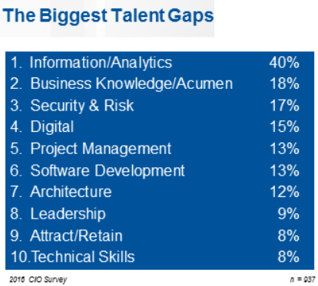
2016 CIO Priorities & Challenges
Talent has now been recognized globally as the single biggest issue standing in the way of CIOs achieving their objectives.
The biggest talent gaps are around Information/Analytics followed by business knowledge/acumen.
Understanding what is possible with the cloud can help close the gap
http://www.gartner.com/imagesrv/cio/pdf/cio_agenda_insights_2016.pdf
Notes:
http://www.gartner.com/webinar/3139617/player?commId=175277&channelId=5500&srcId=1-2973089105

Slide 4






DevOps is the union of people, process, and tools to enable continuous delivery of value of our end uses.
DEV
OPS
1
People
2
Process
3
Tools
Shared Mission: Deliver a great product or service that inspires our customers to become raving fans
Notes:
People = Culture
Fundamental attributes of successful cultures:
Shared mission and incentives: infrastructure as code, apps as services, DevOps/all as teams
You need to consider your hardware as a commodity, (don't give your servers names) , servers are like farm animals, it is just harder if you let theids name them
Build deep instrumentation into services, push complexity up the stack
Rally around agile, shared metrics, CI, service owners on call, etc.
Changing the culture: any change takes time, changing culture is no exception and you can't do it alone, exploit compelling events to change culture: downtimes, cloud adoption, devops buzz
PROCESS Definition and design, compliance, and continuous improvement
PEOPLE Responsibilities, management, skills development, and discipline
Tools and infrastructure

Slide 5
DevOps Is About …
People
Adaptive Teams
Collaborative
Continuous Improvement
Process
Visibility & Accountability
Eliminate Waste
Increase Efficiency
Feedback
Products/Tools
Flexible & Scalable
Interoperable
Enhance Productivity

Slide 6
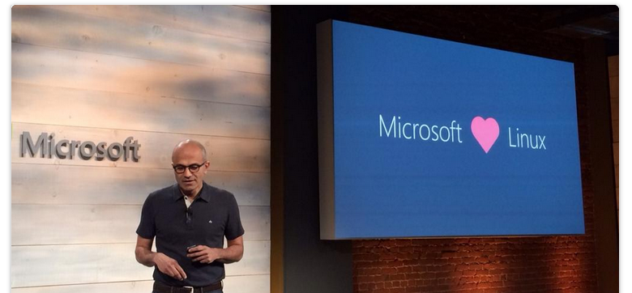
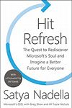

Culture Change & Digital Transformation
Open Source:
Power BI, PowerShell, Visual Studio Code… 2218+ More
Hit Refresh
The Quest to Rediscover Microsoft's Soul and Imagine a Better Future for Everyone
2017 - Satya Nadella, Greg Shaw, Jill Tracie Nichols - Biography & Memoirs
#1 Contributor on GitHub?
http://github.com/microsoft

Slide 7








DevOps is here…
Create
Plan
Release
Configure
DEV
OPS
Package
Monitor
Verify

Slide 8




DevOps is here… and driving business value
Organizations realizing up to 20% improvements in...
Create
Plan
Release
Time-to-market
Configure
Software quality
DEV
OPS
Frequency of deployment
Package
Increased revenue
Monitor
Verify
Customer reach and retention
Source: Global Study by CA Technologies

Slide 9
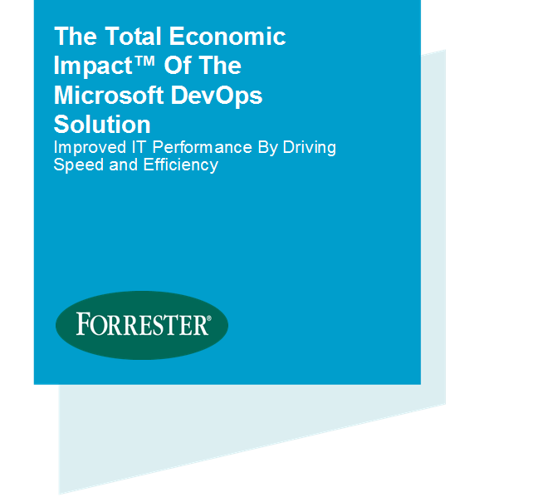
Economic impact summary
$3.9M
NET PRESENT VALUE OVER THREE YEARS
Forrester Consulting, 2016 Based on a composite organization created from surveys and interviews of actual Microsoft customers
529%
three-year, risk-adjusted ROI
80% lower
time to recover from failures
15 times
increase in deployment frequency
3 months
to total payback
Notes:
The economic benefits of DevOps are now universally recognized and accepted.
Organizations that have successfully adopted DevOps …
(Click)
Have seen a 529% ROI over 3 years
(Click)
Have reduced their time to recover from failures by 80%
(Click)
Are deploying their software 15x more frequently
(Click)
And, have seen total payback on these tools and the time spent to implement them in as little as 3 months.
And, Have better morale. Employees in high-performing organizations were 2.2 times more likely to recommend their organization as a great place to work.
As a result, these organizations are able to …
… spend 22% less time on unplanned work/rework, since we have shifted our quality activities to the left in the process
… spend 29% more time on new work, such as new features or code
… experiment in product development, by working in small batches; providing visibility into the flow of work; and gathering customer feedback to iterate.
The Microsoft DevOps solution unlocks DevOps benefits like the ones listed above in record time – investing in DevOps with Microsoft is the easiest way for Enterprise organizations to start their DevOps journey.
Visual Studio Enterprise is at the center of our DevOps solution – if team members are equipped with Visual Studio Enterprise, they have all the tools and services required for modern DevOps.
The total economic impact of the Microsoft DevOps solution
https://info.microsoft.com/the-total-economic-impact-of-the-microsoft-devops-solution.html
C:\Users\daveb\OneDrive - Microsoft\Events\The Total Economic Impact Of The Microsoft DevOps Solution.pdf

Slide 10
DevOps – delivering value in the digital era
22%
29%
50%
75.2x
less time on unplanned work/rework
more time spent on new work
less time remediating security issues
fewer outage costs due to downtime
Employees in high-performing teams are 2.2x more likely to recommend their organization as a great place to work.
Source: 2016 State of DevOps Report (Puppet & Dora), survey of 4,600 technical professionals
Notes:
Digital-minded organizations are adopting DevOps practices as the vehicle for delivering transformation, and are reaping the benefits from doing so.
High-performing organizations spend 22 percent less time on unplanned work and rework. As a result, they are able to spend 29 percent more time on new work, such as new features or code. They are able to do this because they build quality into each stage of the development process through the use of continuous delivery practices, instead of retrofitting quality at the end of a development cycle.
High performers spend 50 percent less time remediating security issues than low performers. By better integrating information security objectives into daily work, teams achieve higher levels of IT performance and build more secure systems.
And a final differentiator – by adopting DevOps standards and practices, employees are 2.2x more likely to recommend their organization as a great place to work.
Source: 2016 State of DevOps Report (Puppet & Dora), survey of 4,600 technical professionals

Slide 11
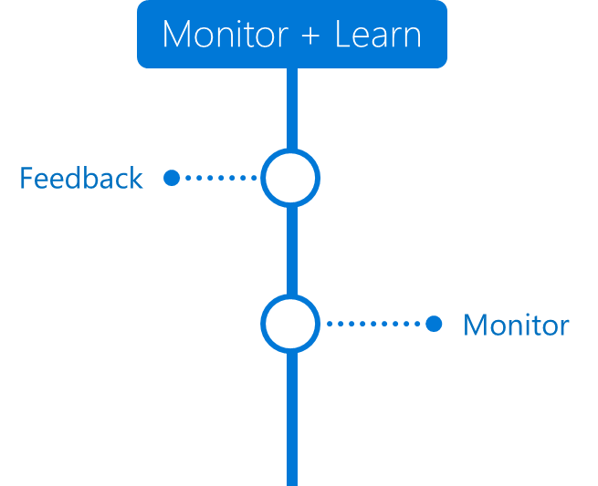
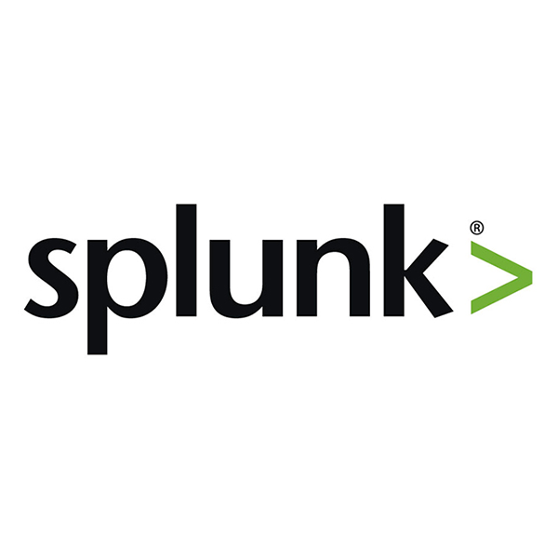


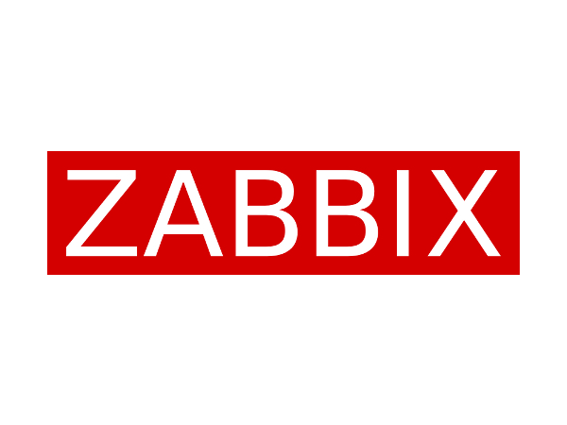
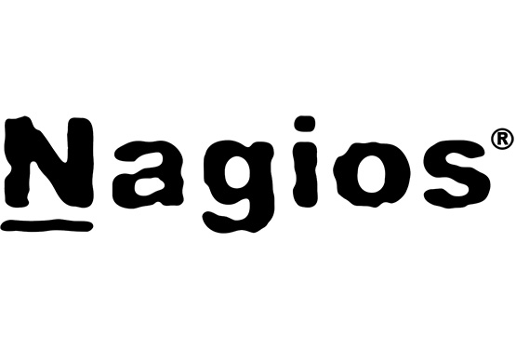
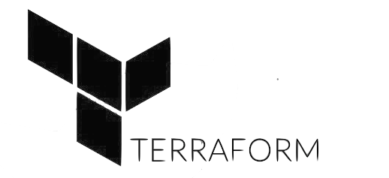
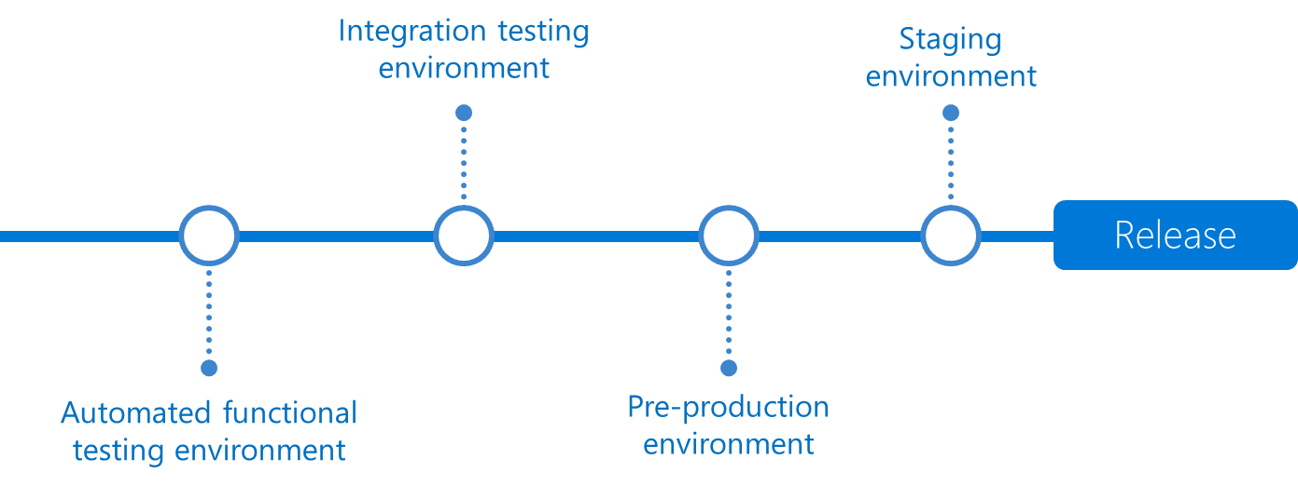
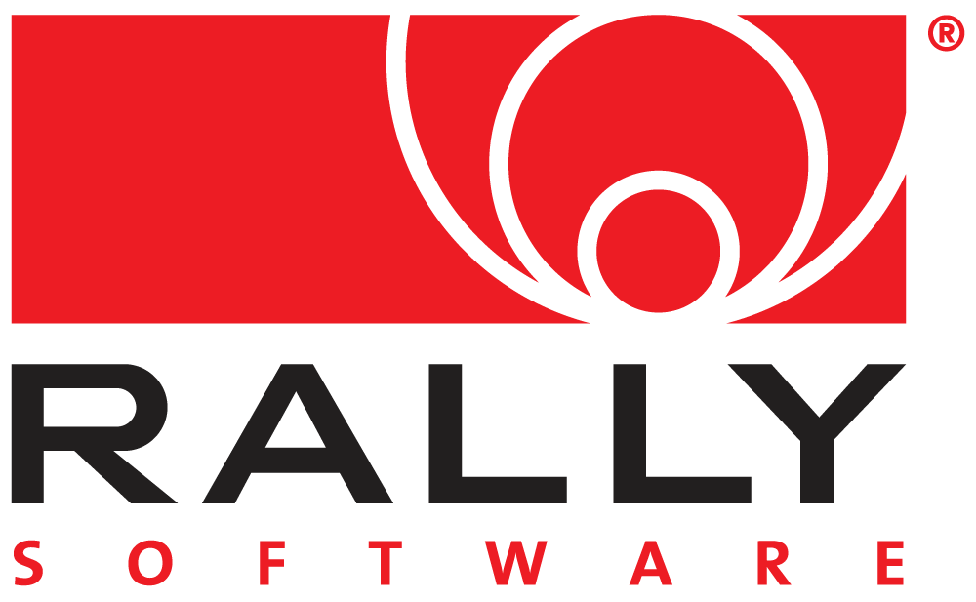


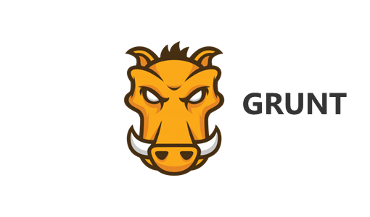
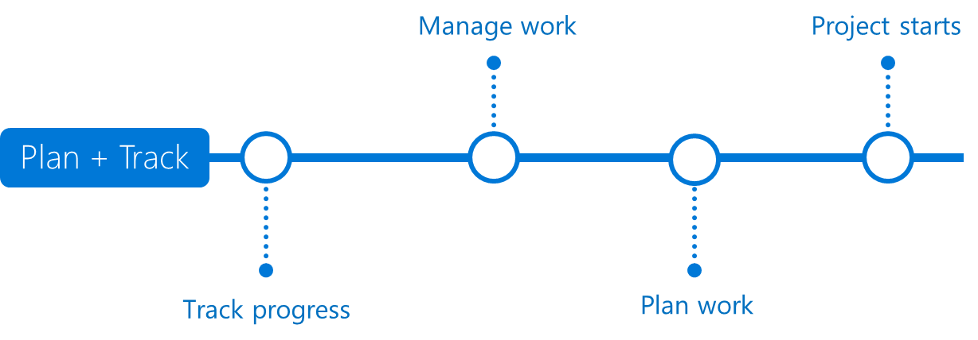

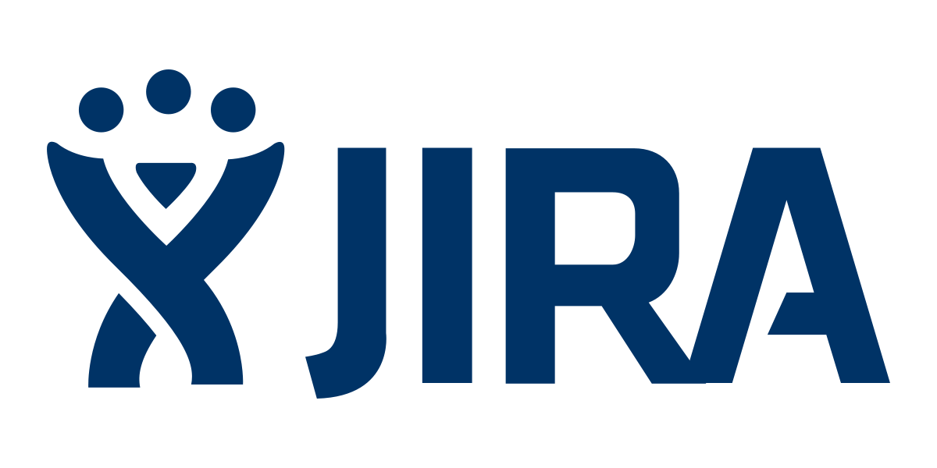

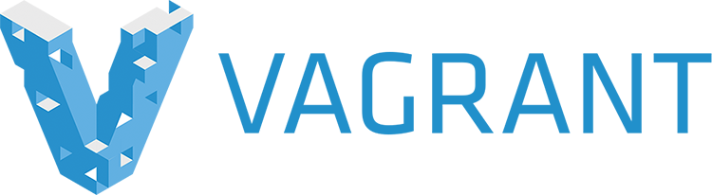



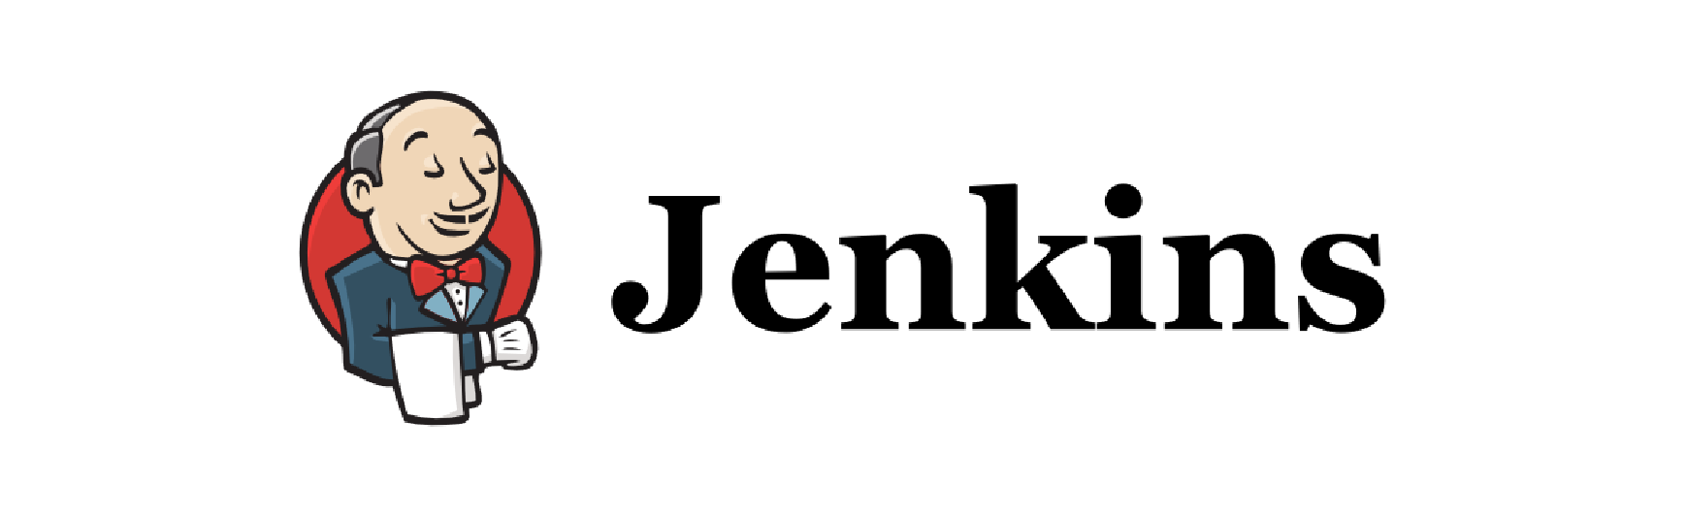

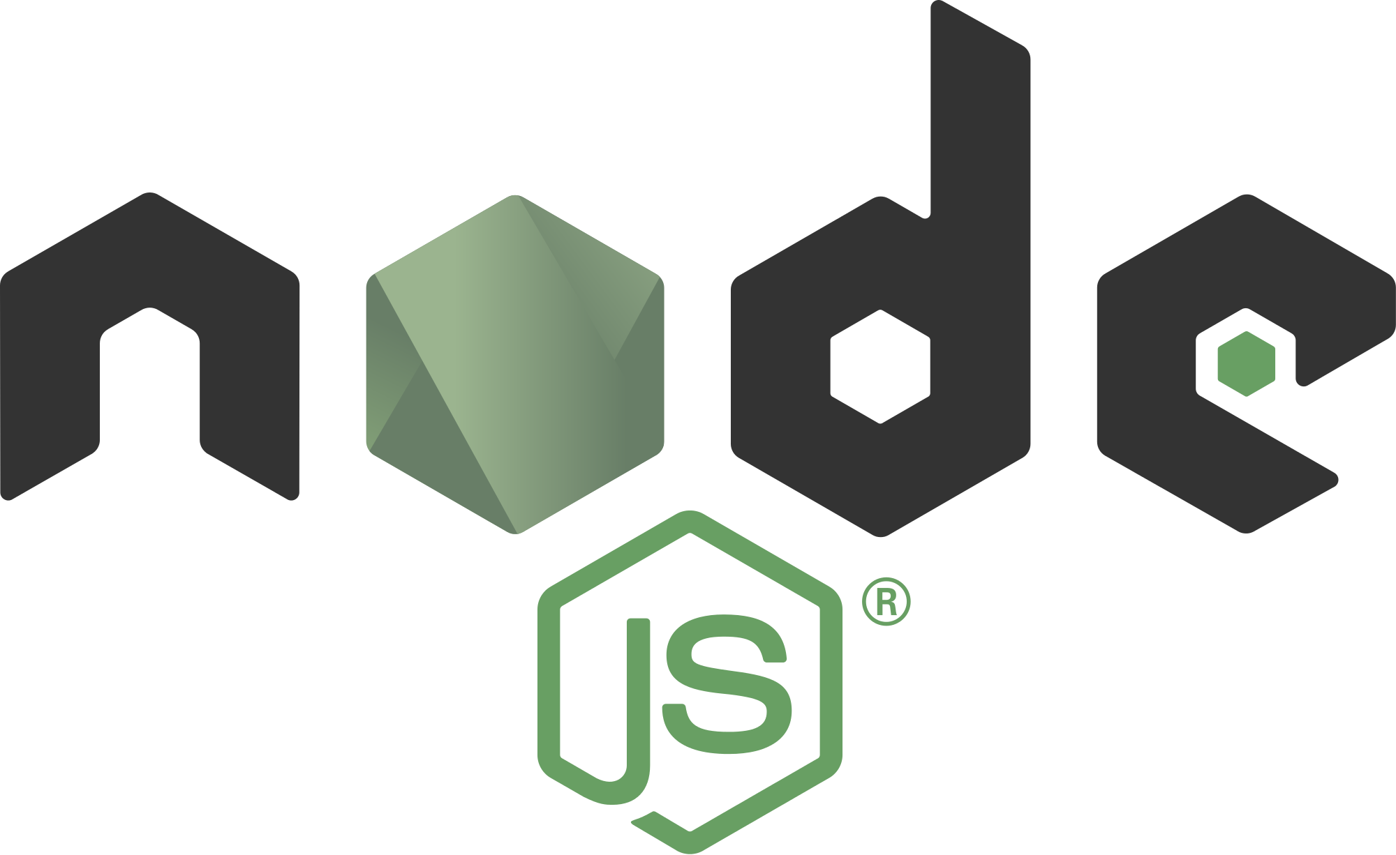
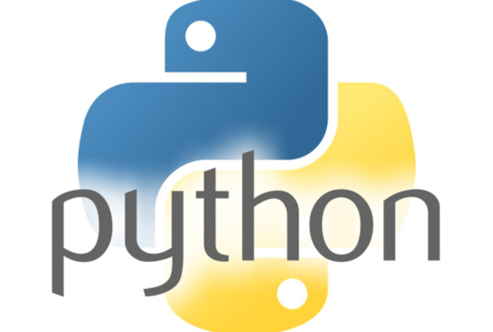
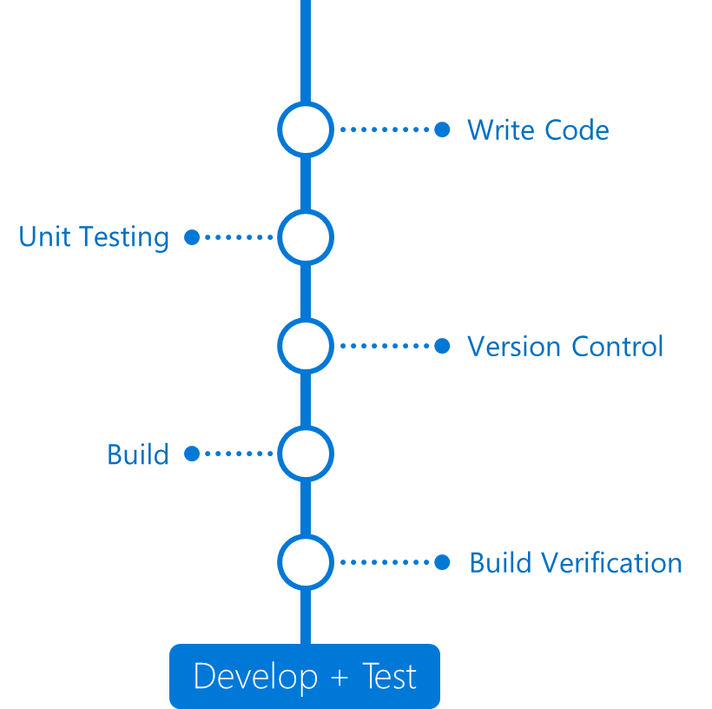

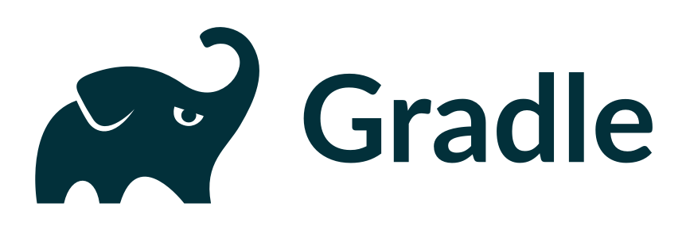

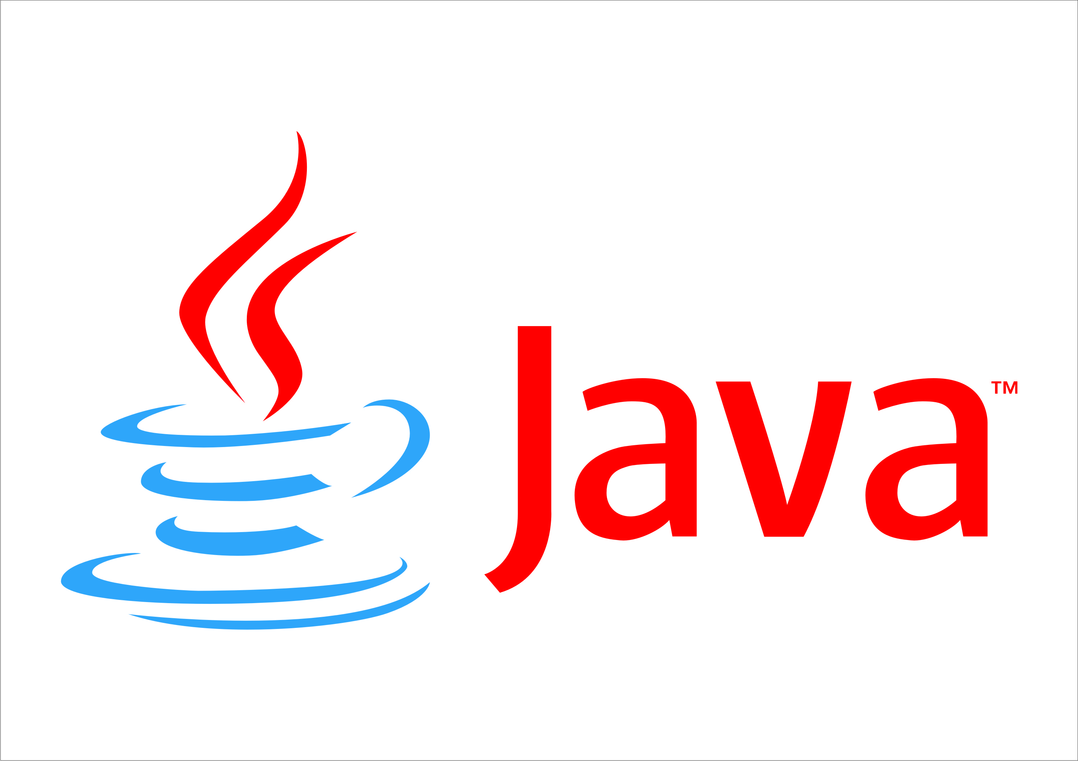
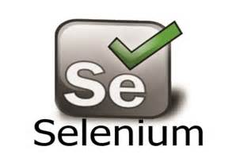
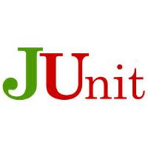
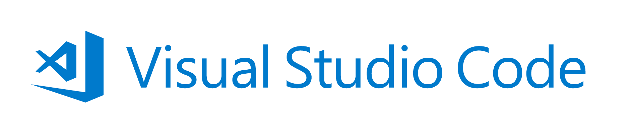
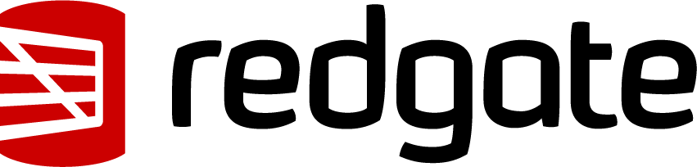
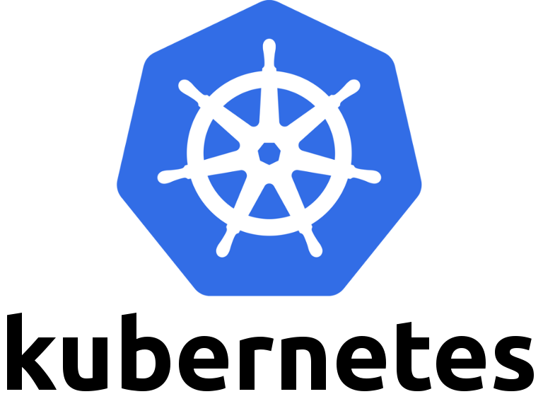


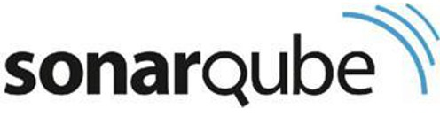
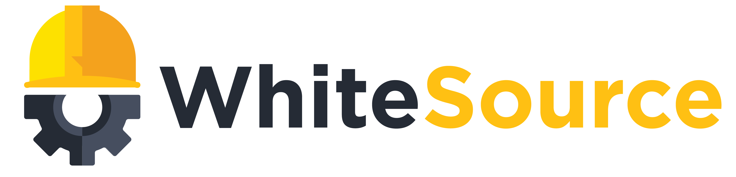
Azure and DevOps are OPEN + DevOps with VSTS
DevOps
DevOps is the union of people, process, and products to enable continuous delivery of value to our end users.
Application Insights
DevOps
DevOps
Visual Studio
https://www.visualstudio.com/devops/
Notes:
Continuously delivering value is about more than just automating deployments. You must start at the beginning of your development process - what you plan to deliver and how you plan to get there. In other words, planning and tracking.
[CLICK – Transition slide to show Planning phase]
Your project starts with an idea and a plan how to turn this idea into reality.
Agile approaches software development by emphasizing incremental delivery, team collaboration, continual planning, tracking and learning.
​
[CLICK – Transition slide to show development and test phase]
Although planning starts the process, the development team turns the ideas into features and capabilities during the development and testing phase.
Your development team will use the practice of continuous integration to merge code and automatically run a build process, including tests, whenever they commits a code change. ​
​
[CLICK – Transition slide to show release]
Continuous delivery will deploy your build to testing, pre-production, staging, and other environments in the release process.
It gives you quality gates throughout your release pipeline and increases confidence in your code long before production. ​
​
[CLICK – Transition slide to show monitor]
Lastly, you need to watch your solution in production. Effective monitoring delivers information about your solution’s performance, usage, and issues.
It’s essential to enable DevOps teams to deliver at speed, get feedback from production, and increase customers satisfaction, acquisition and retention.​
[CLICK – Transition slide to show other products and end with VSTS]
​Whether you are targeting the cloud, hybrid cloud, or an on-prem environment, Visual Studio Team Services, or VSTS, is the recommended Azure DevOps solution.
It allows you to plan, monitor, build and deploy to Windows, Unix, Android, or iOS, from .NET, Java, PHP, Python, Ruby, C++, and many other 3rd party and open source products such as Ant, Maven, Gradle, Junit, NUnit, xUnit, and Jasmine.
If you cannot find a task needed for your release pipeline, you can build custom tasks that integrate with VSTS and your continuous integration and continuous deployment.

Slide 12
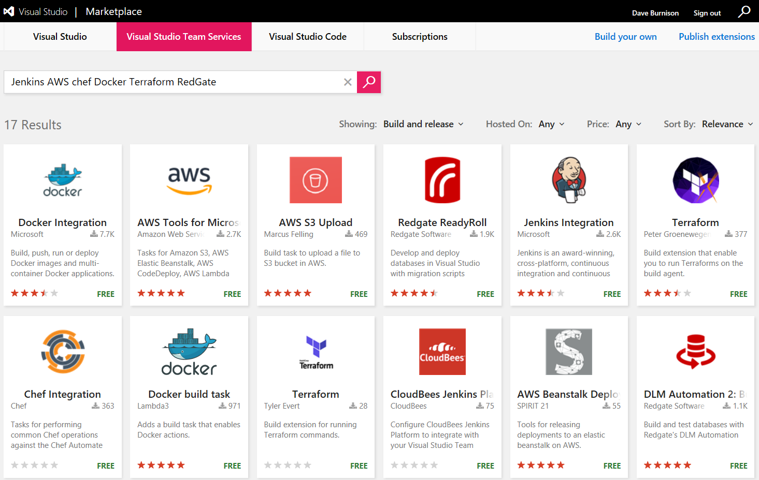
Get 3rd Party Extensions in the VSTS Marketplace
https://marketplace.visualstudio.com/
Notes:
Free and Paid extensions.
Jenkins AWS Chef Docker Terraform RedGate

Slide 13
Let’s Take A Look
GitHub Microsoft > http://github.com/microsoft
VSTS Market Place (Get 3rd Party Extensions in the VSTS Marketplace) > https://marketplace.visualstudio.com/
Azure DevTest Labs - https://azure.microsoft.com/en-us/services/devtest-lab/
DevOps Resource Center - https://docs.microsoft.com/en-us/azure/devops/
DevOps and Microsoft - https://www.visualstudio.com/devops/
Visual Studio DevOps Hands On Labs - https://almvm.azurewebsites.net/
http://github.com/microsoft
https://marketplace.visualstudio.com/
https://azure.microsoft.com/en-us/services/devtest-lab/
https://docs.microsoft.com/en-us/azure/devops/
https://www.visualstudio.com/devops/
https://almvm.azurewebsites.net/
Notes:
Open links from URL field in multiple tabs and just go through the various sites

Slide 14

Monolith/Traditional vs Microservices/born in cloud
Asteroids

Slide 15
Continuous Integration
Use hypotheses driven development
Build frequently and incrementally
Test continuously -- eliminate manual work and automate the flow of software through the build, test, and deploy cycles
Load test early and often

Slide 16
Continuous Deployment
Continuous delivery ensures code is always ready to deploy and performs as expected through automated testing on a production-like environment
Continuous deployment is a process of deploying code which passes the automated tests to production automatically.
Manual Release
Automatic Release
Build
Staging
Production

Slide 17
Continuous Feedback
Use Kanban boards to understand bottlenecks
Make it easy for customers to provide feedback
Use feature flags to encourage early adoption
Retrospectives
Use monitoring to support data-driven decisions

Slide 18
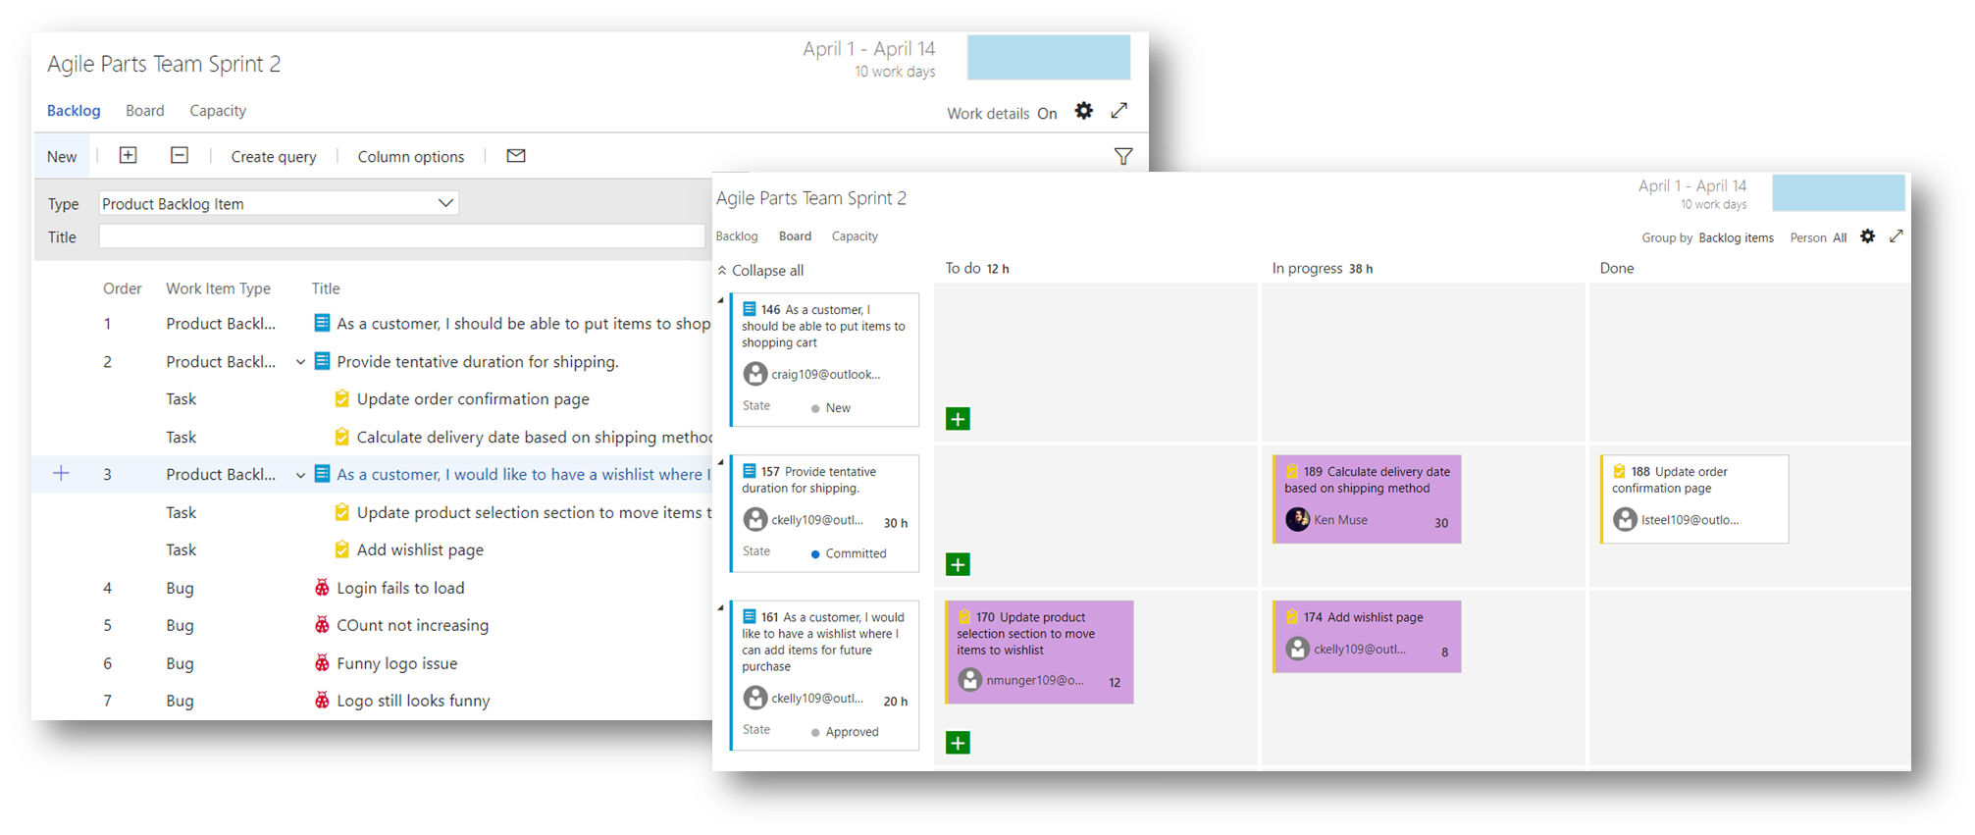
Plan & Track

Slide 19
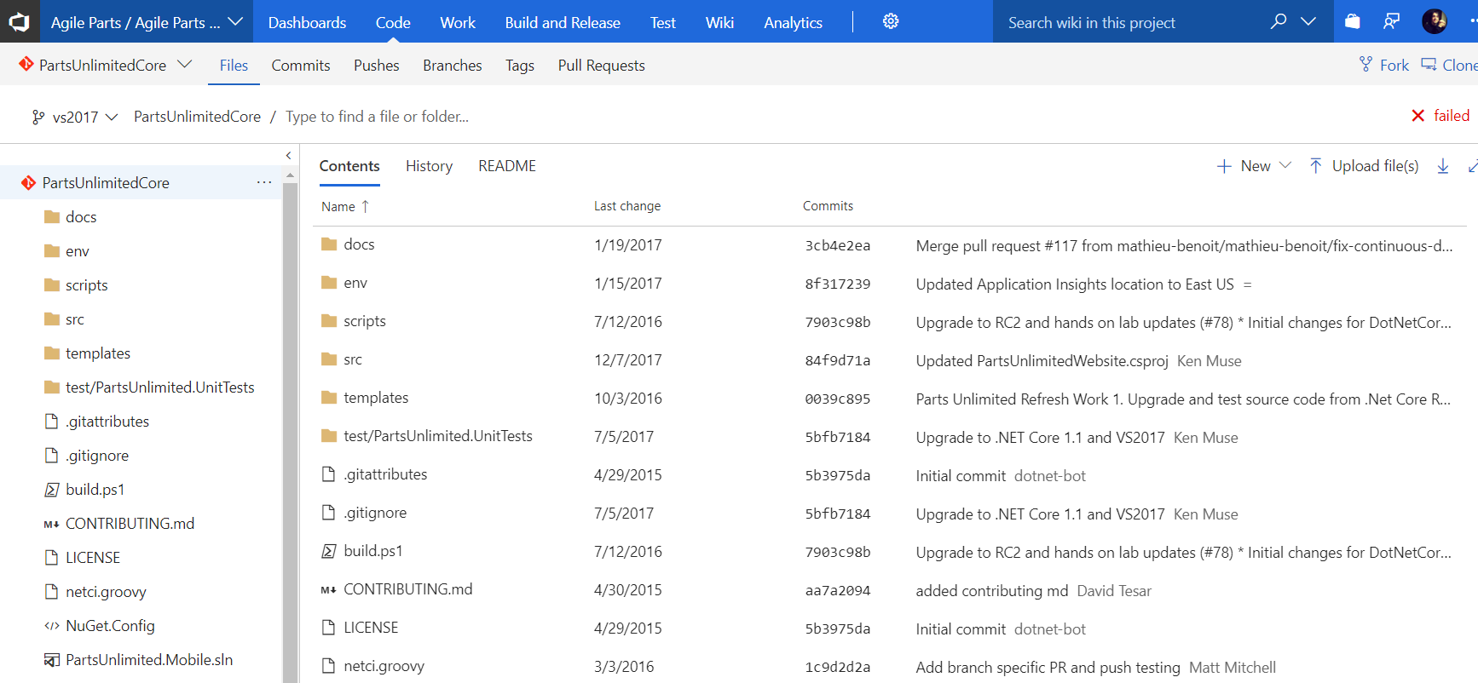
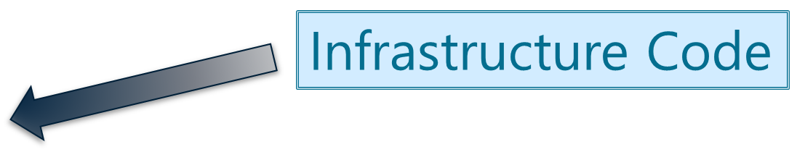
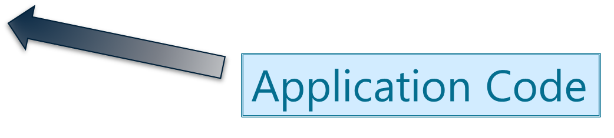
Develop & Test

Slide 20
Build & Release
A Build is responsible for compiling code, gathering resources, and organizing files into Artifacts that can be used in a release pipeline
A Release is responsible for deploying Artifacts into one or more environments and verifying the quality of the deployed release

Slide 21
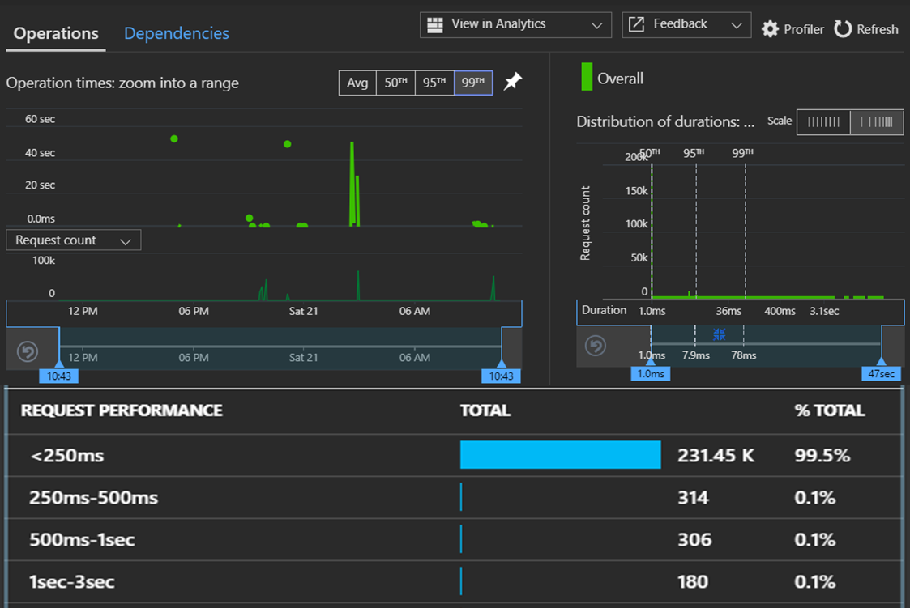
Monitor & Learn

Slide 22
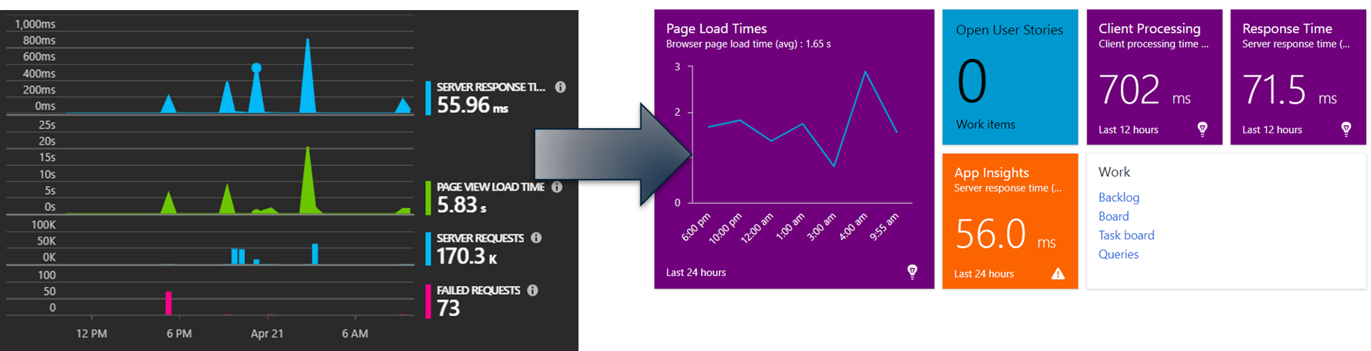
Monitor & Learn

Slide 23
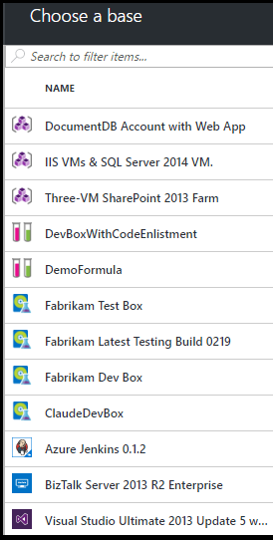
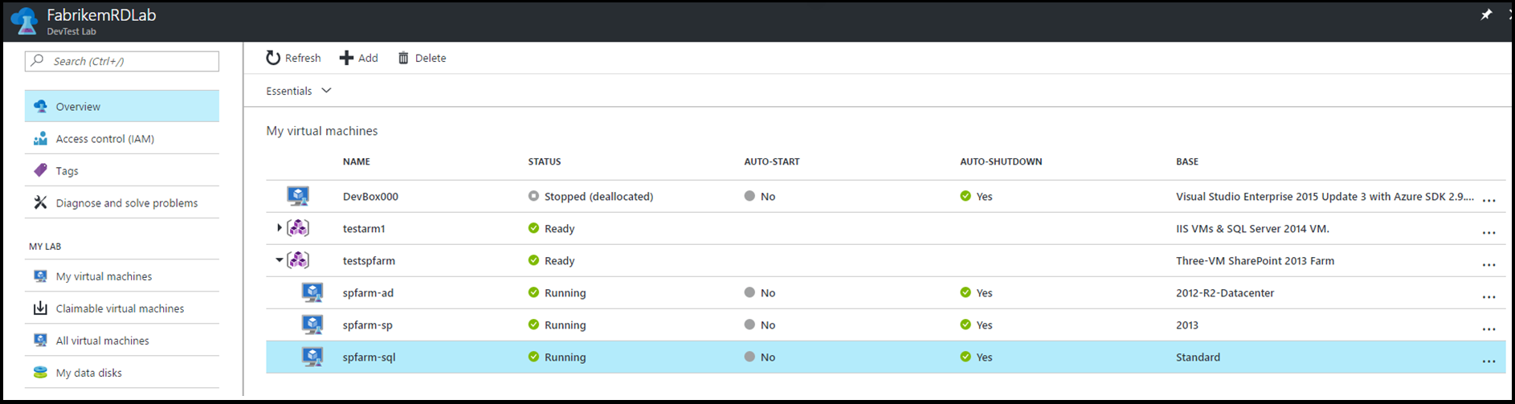
Self-Service Enablement: DevTest Labs

Slide 24

DevSecOps: Security embedded in DevOps
OSS Vulnerabilities
WhiteSource**
Container Security
Aqua**
Static Analysis Security Testing (SAST)
OWASP
SonarQube
AttackFlow
Brakeman
CPPCheck
LAPSE
.NET Security Guard
Coverity*
Parasoft**
VeraCode**
Fortify*
Checkmarx**
This Photo by Unknown Author is licensed under CC BY-SA
* - A commercial brand covering related security products
** - A company selling a security products

Slide 25
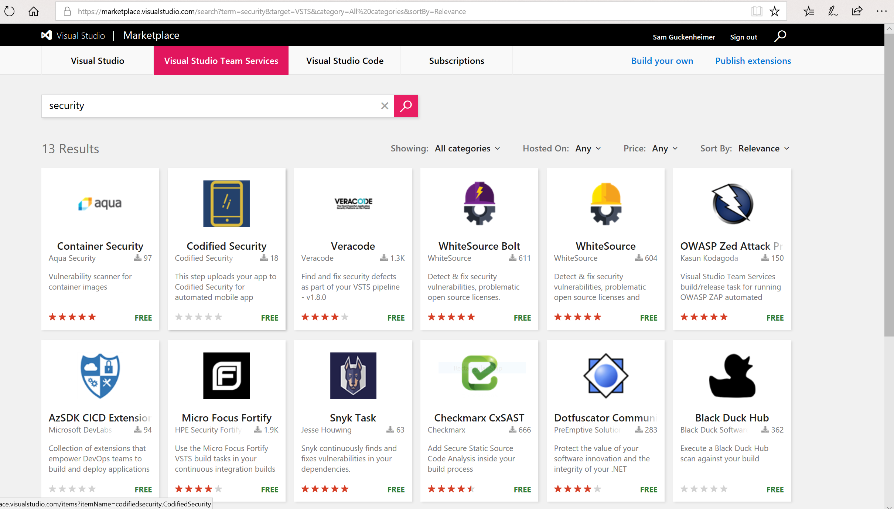

Slide 26
Role of Security in DevOps aka DevSecOps
Incorporate security necessities into every aspect of the business; enable others to automate compliance
Making the business case:
GOVERNANCE
Culture, politics, processes & laws that determine how a company should conduct itself.
Security
Confidentiality
TRUST
Effect if uncertainty on organizational objectives.
Availability
Act of adhering & demonstrating adherence to laws, regulations, corporate policies & procedures.
Integrity
Privacy
COMPLIANCE
RISK
Help build a product/service that inspires our customers to become raving fans

Slide 27
Roles and Responsibilities
Security - Incorporate security necessities into every aspect of the business; enable others to automate compliance
Development – Quickly build, deploy & update a product that our customers love; Enable other groups by building what they need to support you.
IS/IT – Build infrastructure as code; enable others by helping to eliminate waste throughout the technology landscape
Management – Enable the teams by giving them flexibility, guidance and support to do what is needed; remove obstacles
Senior Management – Embrace Cultural Change; Drive Transformation in the organization.
Everyone – Help build a product/service that will inspire our customers to become raving fans
Notes:
Security - Help find a way to incorporate security necessities into every aspect of the business; without getting in the way unnecessarily

Slide 28


Use and orchestrate your favorite 3rd party tools. Your toolchain, seamlessly integrated with Azure.
“Azure support for Docker, Kubernetes, Puppet, Terraform, Cassandra, and other open source tools has become very important to us and has really accelerated our move into Azure.” – Robert Rudduck, Director of Architecture and DevOps Read the story
Notes:
Key quote:
The CI/CD process includes Infrastructure as Code, which allows security, networking, storage and compliance to be part of the development life cycle. When code is ready to deploy, it and the infrastructure on which it will run are deployed in tandem. Developers define the entire infrastructure using Azure platform services and open source tooling—Azure Resource Manager, Puppet, Terraform, and Microsoft Visual Studio Team Services.

Slide 29
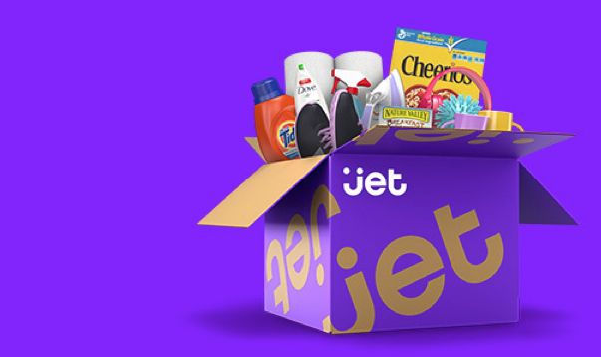
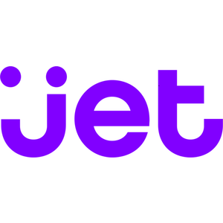
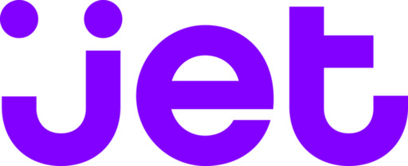
Spend less time building delivery pipelines and more time delivering software
E-commerce challenger eyes the top spot, simplifies development and delivery with DevOps on Azure “Being able to leverage so many off-the-shelf services and tools from Azure enabled us to go from zero to a full- fledged e-commerce marketplace in just about 12 months.” – Mike Hanrahan, CTO Read the story
Simple
“Being able to leverage so many off-the-shelf services and tools from Azure enabled us to go from zero to a full- fledged e-commerce marketplace in just about 12 months.” – Mike Hanrahan, CTO
Read the story
Notes:
Key quote:
The Microsoft Visual Studio development system is the primary IDE for back-end infrastructure, with Node being used on the front end. To get its code through development and into production as fast as possible, Jet uses a mix of Azure App Service, Azure Web Roles and custom servers, with deployment happening from Jenkins.

Slide 30


Deploy continuously and compliantly to enterprise-grade cloud services, with integrated security and monitoring.
“With DevOps and Azure, we’re able to reduce our new-feature release cycle down to one week, and we think we can even speed that up.” – Fikri Larguet, Director of Cloud Services
Read the story

Slide 31
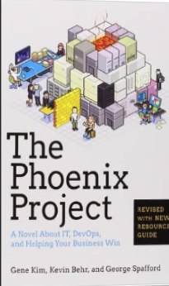
Tip: Must Read Book
The book is available on Audio Book; you can likely get it for free, if you do not already have an account. If you do not have an Audible Account, you get two free books when signing up for your free account.
Amazon…
The Phoenix Project: A Novel about IT, DevOps, and Helping Your Business Win Paperback
– October 16, 2014
This is the BEST IT Book I have ever read. – Dan Stolts
https://www.amazon.com/Phoenix-Project-DevOps-Helping-Business-ebook/dp/B00AZRBLHO
Notes:
TAKE A PICTURE OF THIS SLIDE!
https://www.amazon.com/Phoenix-Project-DevOps-Helping-Business-ebook/dp/B00AZRBLHO

Slide 32
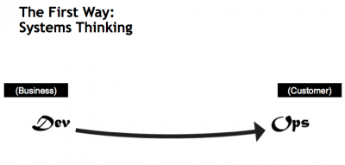
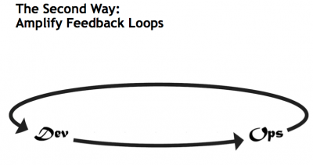
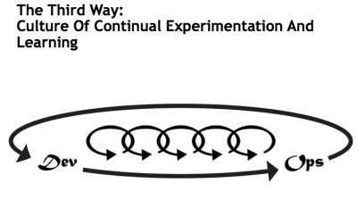
What is DevOps…
Gene Kim’s “3 ways”
The First Way emphasizes the performance of the entire system, as opposed to the performance of a specific silo of work or department — this as can be as large a division (e.g., Development or IT Operations) or as small as an individual contributor (e.g., a developer, system administrator).
The Second Way is about creating the right to left feedback loops. The goal of almost any process improvement initiative is to shorten and amplify feedback loops so necessary corrections can be continually made
The Third Way is about creating a culture that fosters two things:
continual experimentation
Taking risks and learning from failure; and understanding that repetition and practice is the prerequisite to mastery.
http://itrevolution.com/the-three-ways-principles-underpinning-devops/

Slide 33
DevOps Journey
Not Started?
Already started:
Feel you should be able to get results faster
It is too hard
Takes too long
There is too much bureaucracy
DevOps should be fast!!!
Let Microsoft show how to kick your journey into high gear. Where you are executing at top speed with lower amounts of energy being consumed. [Free options]
How to Join: Reach out to your Account Team; cc dstolts@microsoft.com
Alert: Many pre-req’s
“There are many secrets to showing quick results with DevOps. Results, where the true value of DevOps can be realized in just a few weeks” – Dan Stolts, Chief Technology Strategist, Microsoft

Slide 34
Kickstart Your DevOps Journey With Microsoft Help 5 Step Process and just a few weeks of work
Introductory Meeting [1.5 hours]
Quick review of pipeline: Feedback.. Production -> Planning/Ideation. This review will help us answer the following:
Identify primary tools, processes and perceived weaknesses if any
Define needed participants/roles to be included in VSM (and hack) - includes name, email address, tittle, role (Homework?).
Schedule Value Stream Mapping (VSM)
If time, identify any training desired
Architectural Design (ADS) [1 day]
Value Stream Mapping (VSM) [1-2 days]
Around the room intro’s, DevOps Training
Whiteboard Value Stream Map – Current with Waste Identified
Working Lunch’s
Whiteboard Value Stream Map – Future with Waste eliminated
Plan hack priority - {if needed}, Define Success, Identify expected outcomes, Assign Homework – if needed
Lock hack dates
Training (Docker, VSTS, Azure, Hybrid, whatever) if needed and time permitted
Hack with Microsoft on your projects [2-5+ days]
Day 1 - Setup Teams; Identify requirements, Identify scribe; Perform Training; Hack rest of day 😊
Day 2- Hack all day ☺ 3pm Team scrums
Day 3-? Hack all day ☺
Last Day
Morning Test process; tweak as needed
Document – outline will be provided; Teams can use to share their success with their leadership
Working Lunch
Afternoon Document; Create follow-up plan (future hacks, deploy in production, work on different part of pipeline, etc)
2:30-3:30pm; 10-15 mins team presentations to all hackers and Q&A from other hack teams
Provide Feedback using Event Feedback URL
Plan Project Phase II
Define Post hack Schedule
Leadership team discussions of projects and priorities
Plan continued hack schedule
4:30pm hack ends
Rinse / Innovate /Repeat
5 Step Process
“There are many secrets to showing quick results with DevOps. Results, where the true value of DevOps can be realized in just a few weeks” – Dan Stolts, Chief Technology Strategist, Microsoft

Slide 35
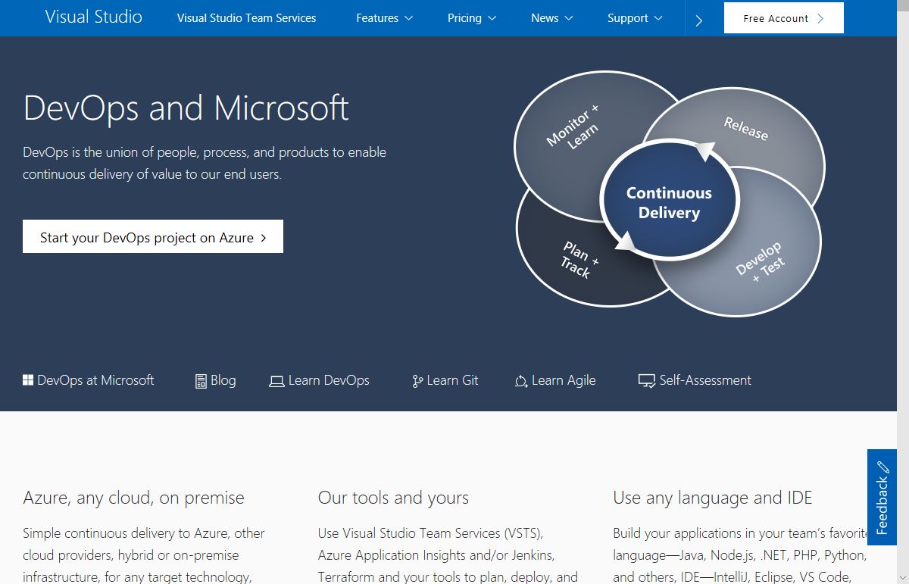
https://www.visualstudio.com/devops/

Slide 36
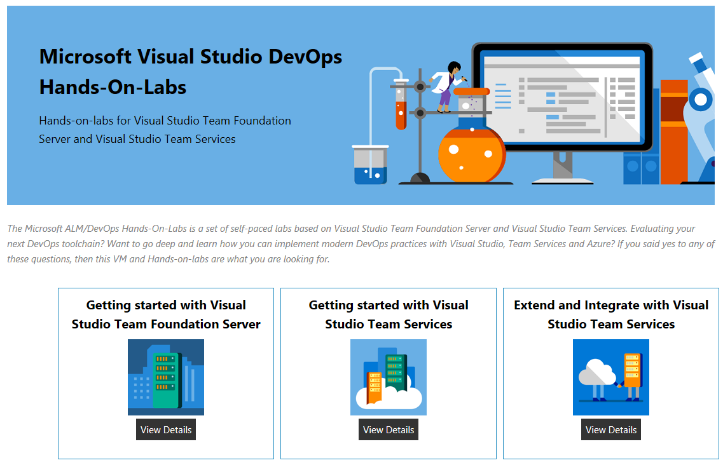
https://almvm.azurewebsites.net/

Slide 37
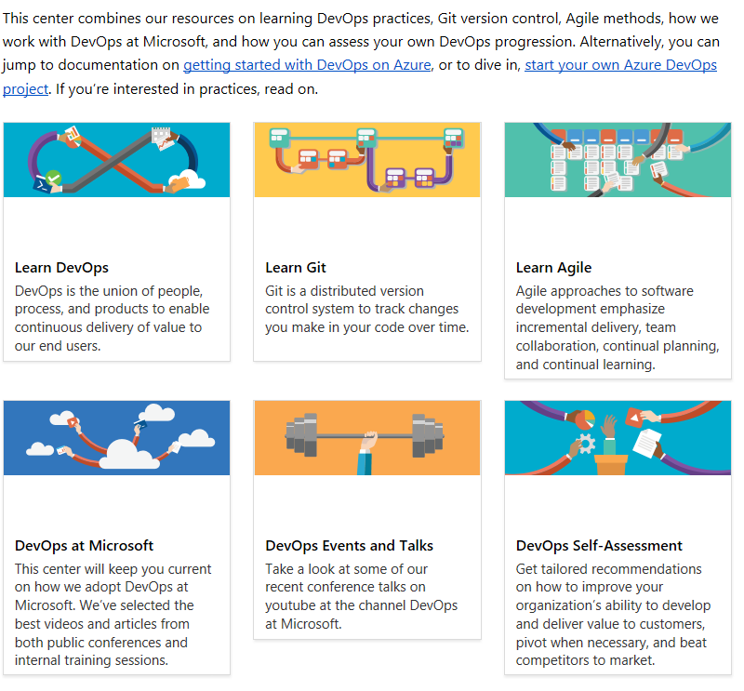
DevOps Resource Center
https://docs.microsoft.com/en-us/azure/devops/

Slide 38
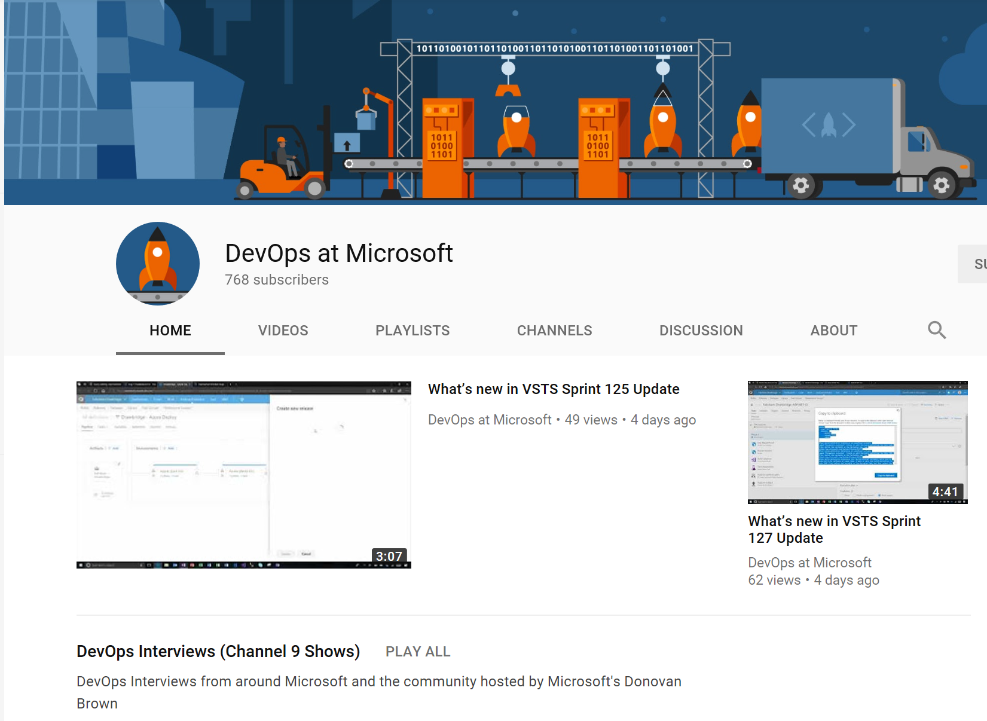
Subscribe to the ”DevOps at Microsoft” YouTube channel
https://www.youtube.com/channel/UC-ikyViYMM69joIAv7dlMsA
Notes:
TAKE A PICTURE OF THIS SLIDE!

Slide 39
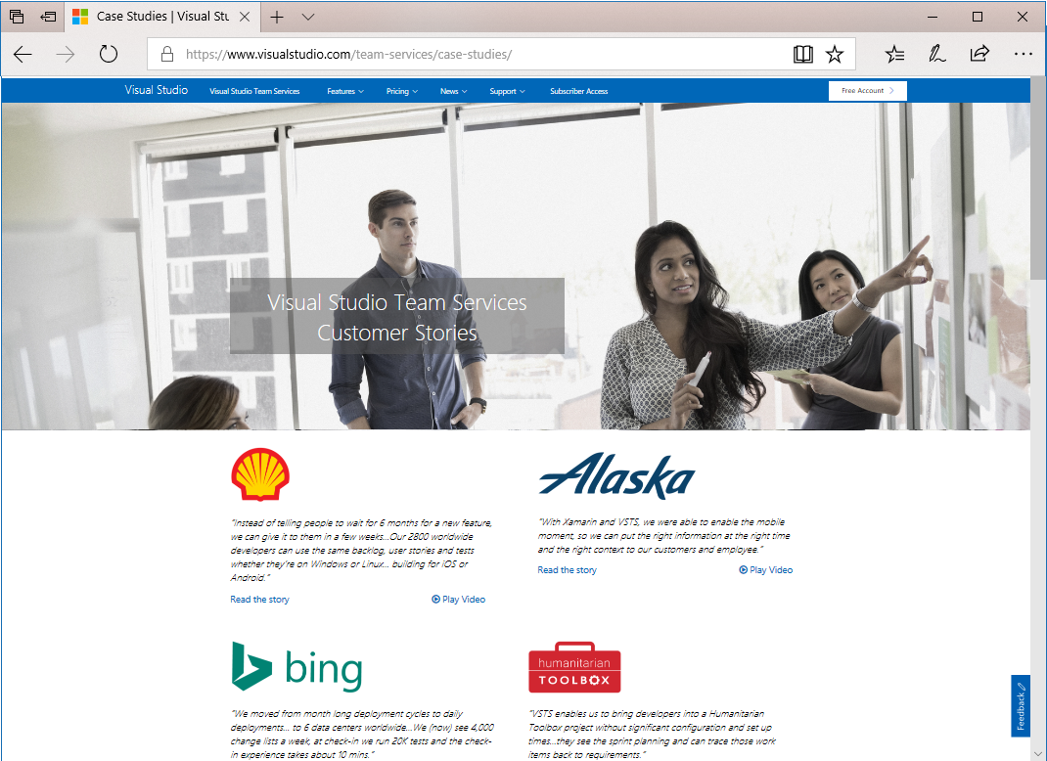
How are other customers continuously delivering value to their end users with DevOps? Check out our VSTS Customer Stories:
https://www.visualstudio.com/team-services/case-studies/

